Slide 1
Sprint Review
Tables All The Way Down

Slide 2
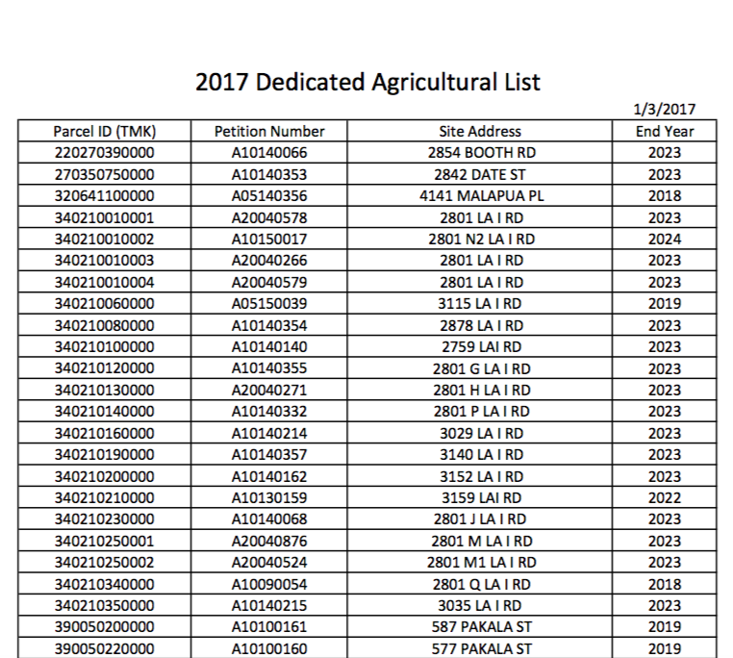


Tables in a PDF
Often data is found in tables in a PDF
That data wants to be free, but needs your help

Slide 3


Tables in a PDF
There are various means to extract those tables:
Applications, Web apps, R packages, etc.,
They will often have different outputs (one vs multiple tables)

Slide 4
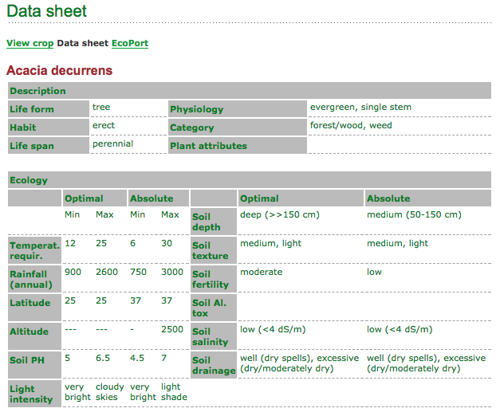

Tables in HTML
<tables> are also found in HTML code
Sometimes handily notated, often not
You can even have tables inside tables

Slide 5
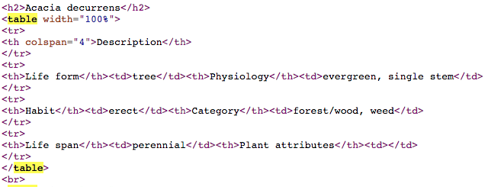
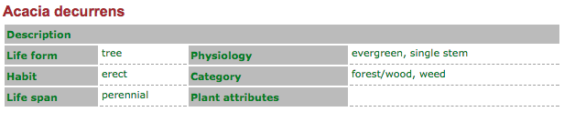
Tables in HTML
<tables> are also found in HTML code

Slide 6
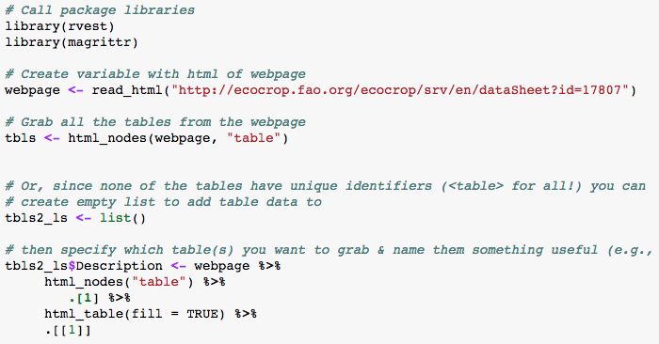
Tables in HTML
Webscraping can help extract from html tables
rvest is a good package for this

Slide 7

Tables in R
SO MANY KINDS OF DATA:
Vectors. a <- c(1,2,5.3,6,-2,4) # numeric vector. ...
Matrices. All columns in a matrix must have the same mode(numeric, character, etc.) ...
Arrays. ...
Data Frames. ...
Lists. ...
Factors. ...
Data Frames

Slide 8
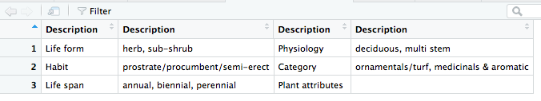
Tables in R
Scraped html tables can be stored as various data types in R
Getting them to compile into a single table require unknowable volumes of magic

Slide 9


In Summary
Damn near everything can be rendered into a table format, including tables
Tables are everywhere
You might be a table
If not, R can help you wish you were

Slide 10
Pau

